Slide 1
Gender Equity & Sexual Misconduct
Reporting
Azure Swinford
Civil Rights/Title IX Investigator

Slide 2
After finding it impossible to gain medical school admission due to her gender, Patsy Takemoto Mink authored Title IX to ensure that women would never face the same discrimination that she endured. Mink was the first woman of color and Asian American Woman to serve in the United States Congress and faced years of sexist rhetoric, racism, and opposition to her legislation. Yet through her perseverance, Title IX passed on June 23, 1972, and forever changed the landscape of education in America.
With this legislation, equal education, opportunity, and protection is afforded to all Americans regardless of their gender, gender identity, sexuality, and parental status.
At Butler University we are honored to continue Mink’s devotion to equity, inclusion, and belonging and consider it our mission to instill Mink’s passion for justice in our students.
Notes:
What is Title IX?
TIX is a part of the Civil Rights Amendments and was added in 1972.
Our mission regarding this work is to prevent and respond to sexual misconduct in the Butler community.
You might hear people talking about the “Title IX” process or making a “Title IX” report. We are moving away from that language, and instead will be talking about the sexual misconduct process and sexual misconduct reports. It more accurately reflects the work that we do at Butler.
Fun Fact is Indiana’s own Birch Bayh signed Title IX into law alongside Patsy Mink, HI

Slide 3
What we will cover today:
What should be reported?
Who should report?
How to report?
How to respond?
Student Parental Accommodations
Scenarios

Slide 4
What should be reported?
Sex- and gender-based discrimination and harassment
Sexual harassment
Sexual assault
Sexual exploitation
Dating violence
Domestic violence
Stalking
Pregnancy or Maternity Discrimination
Notes:
Sex & gender based discrimination- discrimination comes in many forms- exclusive membership, unfair grading practices, harassment by language, slurs, terminology, creating an unwelcoming environment with language and behavior
Sexual harassment- unwelcome, inappropriate sexualized behavior and language
Sexual assault- unwelcome sexual contact
Sexual exploitation – online, social media, sharing nudes or videos with others, trafficking and coercion
Dating violence
Domestic violence- spouse or living together
Stalking- unwelcome persistent contact
Pregnancy – exclusion from school or related activities, pregnant students also have protections and rights to accommodations

Slide 5

What color do you see?
Brown
Gray
Taupe
None of the above
Notes:
We all perceive experiences differently. 1 size does not fit all, therefore following our established guidelines takes the determination off of you as reporters. When in doubt, report. We will be happy you did and will follow up with anyone for better understanding. Always feel free to contact us with questions or request training.

Slide 6
When in Doubt, Report.
Sexual misconduct is complicated.
Leave the decision-making to the Title IX Office.

Slide 7
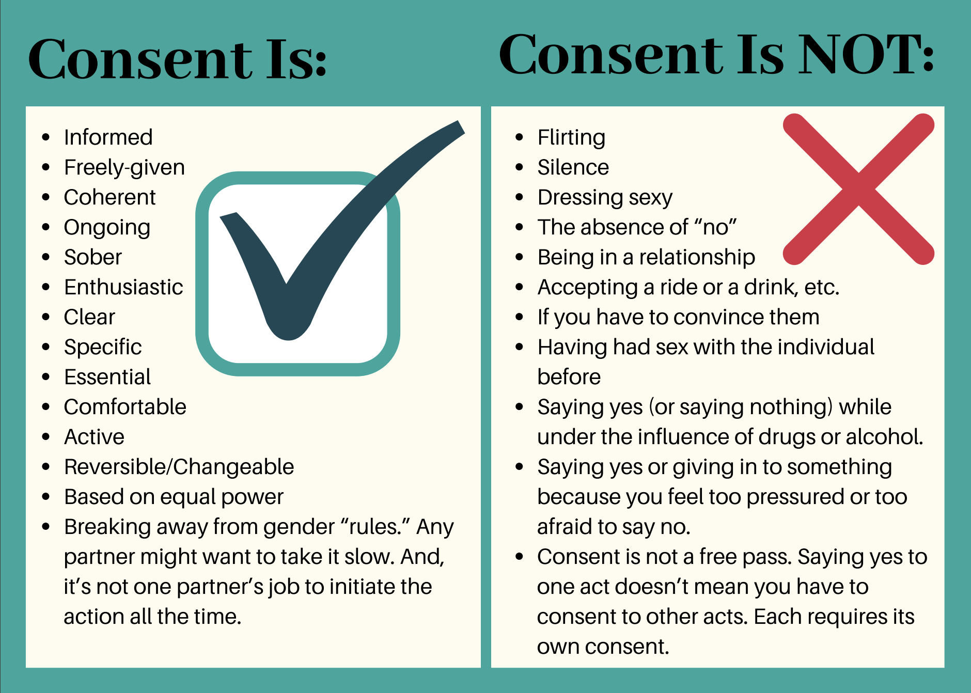
Notes:
Please shout from the rooftops that if you are uncertain you have received consent- err on the side of caution and proceed as if consent was not given.
This is helpful to understand as staff, as well, with students in regards to professional conduct and touching- hugs, shoulder pats, etc. Students do not give up body autonomy when they enter our classrooms and offices.

Slide 8
Who should report?
Responsible Employees
  Most all University employees have an obligation to report when they become aware of sexual misconduct regardless of where the misconduct took place
  This extends to Student employees
Butler wants to ensure
    Everyone on campus is safe
    People who have experienced sexual misconduct are aware of the rights, options, and resources available to them on campus and in the community
Notes:
I’ve dropped a 1-pager in the chat for you. https://www.butler.edu/student-life/wp-content/uploads/sites/22/2022/05/Employee-Reporting-Expectations-handout.pdf

Slide 9
When in Doubt, Report.
If you don’t know whether you are “confidential,” you probably aren’t.
You should report it.
Notes:
Who are confidential resources?
If an individual wishes to speak to someone confidentially, there are several resources available on campus. The following resources are designated as confidential, and therefore not expected to report to the University when made aware of sexual misconduct: −
The Sexual Assault Response and Prevention Specialist (SARP Specialist): 317-910-5572; HRC 101; https://www.butler.edu/sarp/advocacy.
Counseling and Consultation Services: 317-940-9385; HRC 120; https://www.butler.edu/counselingservices
Health Services: (317) 940-9385; HRC 110; https://www.butler.edu/health-services
Pastoral care at the Center for Faith & Vocation: (317) 940-8252; Blue House; https://www.butler.edu/cfv

Slide 10
Campus Confidential Resources
Sexual Assault Response and Prevention Specialist (SARP)
  HRC101 – 317-940-5572
Counseling & Consultation Services
  HRC120 – 317-940-9385
Health Services
  HRC110 – 317-940-9385
Center for Faith & Vocation Pastoral Care
  Blue House – 317-940-8252
Notes:
Who are confidential resources?
If an individual wishes to speak to someone confidentially, there are several resources available on campus. The following resources are designated as confidential, and therefore not expected to report to the University when made aware of sexual misconduct: −
The Sexual Assault Response and Prevention Specialist (SARP Specialist): 317-910-5572; HRC 101; https://www.butler.edu/sarp/advocacy.
Counseling and Consultation Services: 317-940-9385; HRC 120; https://www.butler.edu/counselingservices
Health Services: (317) 940-9385; HRC 110; https://www.butler.edu/health-services
Pastoral care at the Center for Faith & Vocation: (317) 940-8252; Blue House; https://www.butler.edu/cfv

Slide 11
How to Respond?
Ensure that they are safe
  If anyone is in immediate danger, call BUPD ASAP 317-940-9396
Listen without judgment
  Remember, there is no standard response to experiencing sexual misconduct
Allow them to share as much or as little information as they would like
  It is NOT your job to investigate
Notes:
Responding by telling them
Thank you for sharing this with me. I’m sorry this happened to you. I’m here to listen.
Are all statements that allow the person to continue to share or not.
You don’t need to share your opinions and if you can, avoid sharing your own anger/shock or high emotional reactions.
Located in: Butler University
Address: 525 W Hampton Dr, Indianapolis, IN 46208
Phone: (317) 940-9396

Slide 12
When someone discloses to you…
Make them aware of their options and resources
  Confidential resources: medical assistance, counseling, clergy, SARPS*
  Reporting options: Title IX Coordinator, BUPD or local law enforcement
  Community resources: Julian Center, Families First
Avoid directives and/or “should” statements
  “You really should go to the doctor and get checked out.”
  “We need to report this to the police. You can’t let this person do this to someone else.”
Notes:
Note SARPS responsibility to report certain crimes - rape on campus and other criminal activity for the Clery Act.

Slide 13
Explaining Your Role as a Responsible Employee
If you are concerned that the student is not aware of your reporting obligations
  tell them that you want to hear them but you also want them to be fully informed of your obligations before sharing
Be mindful when stopping the person from sharing
“Before you tell me anything, I need you to know…” Can have a chilling effect
Do share the confidential resources with them
Do NOT promise confidentiality
Notes:
Be prepared the person may stop wishing to speak with you – or go silent.
Let them know of the confidential resources and other options that way they know who to speak to next if they decide to not continue sharing with you.

Slide 14
Explaining Your Role as a Responsible Employee
“Thank you for sharing this information with me. I want you to know that I’ll need to share what you’ve told me with the Title IX Coordinator. I won’t share this information with anyone else who doesn’t have a legitimate need to know. This information will be kept as private as possible, and you won’t be required to share any other information with the University. You can share as much or as little as you would like.
The reason I need to make this report is that we want to make sure you are safe and aware of resources on campus and in the community. We also want to make sure that the Butler community is safe.”
Notes:
The TIXC will reach out to the person and invite them to connect. If the person does not respond after the third attempt, nothing more will be done.
Remember you are not snitching and for example - if a complainant was drinking, they will not be disciplined if that comes out as a part of the report.
Title IX is NOT LAW ENFORCMENT – our process and regulations are completely separate.

Slide 15
How to report?
Submit an online report
  Easiest way to report
  Include all information that was provided to you, including names
  Be as clear and thorough as possible
  Do NOT include your personal opinion
  Online report form can be found at www.butler.edu/sexual-misconduct
Can also call 317-940-6509 or email titleix@butler.edu
Keep this information as private as possible
Notes:
Write all of the details that you know. This helps our office determine next steps. Sometimes next steps change dependent on the smallest of details. Where and when and how frequent are important factors.
If you are unsure whether it is a bias or sexual misconduct report, it’s ok. Some of them intersect. You do not need to make two separate reports. We will get the report and if needed file it in the appropriate place, separate out, or combine reports.

Slide 16
After a report is submitted…
The Title IX Coordinator will reach out to the complainant via email
  Email will include:
    An invitation to meet
    Information about their rights, options, and resources
    Link to the sexual misconduct website
It is entirely up to the complainant whether they wish to respond to the email
  If there is no response after about a week, one follow-up email will be sent. If there is no response to the follow-up, there will be no further outreach from the Title IX Coordinator.
  They can contact our Office of Title IX after a period of time has passed
Notes:
There’s not a limitation of time – if a student or staff wished to contact us after a semester, the summer, or an entire school year has passed, they are still able to speak with us, have protections, have rights to accommodations, and can file a formal grievance.

Slide 17
After a report is submitted…
The complainant will be offered options for resolving the report
  They will not be compelled to participate in any University process
Making a report does not mean that the formal Administrative Investigation Process will take place automatically
If a complainant decides not to move forward with a formal resolution, the University may determine that an Administrative Investigation Process needs to take place
  This happens rarely, and is usually due to safety considerations
  The complainant will be given the option to participate, but will not be required to participate
Notes:
Options for resolving the report include: no University action, informal resolution, or formal resolution through an Administrative Investigation Process

Slide 18
Student-Parental Accommodations
In October 2022, the Office for Civil Rights (OCR) reaffirmed that Title IX prohibits discrimination towards any student experiencing pregnancy, loss of pregnancy, termination of pregnancy, etc.
What this means is students who are pregnant, have given birth, or have a loss of pregnancy are protected and have rights to accommodations to ensure they have equal access to education
Notes:
This has always been the case for Title IX, but many education institutions across the country have not participated in assuring their pregnant and parenting students had access to their rights to accommodations, nor trained staff. OCR & Dept of Education recognized this and addressed it so that our pregnant and parenting student population who drop out of High school and college have systems in place to support them.
If you know of a peer who may be pregnant, please know this is reportable and we share their options with them.

Slide 19
Student-Parental Accommodations
Faculty and Staff must make reasonable accommodations for students experiencing pregnancy and pregnancy-related conditions.
Those accommodations may consist of:
  Excused absences
  Extensions of deadlines
  Late Withdrawal from a Course
  Incomplete assignment
  Traditional disability accommodations such as extended exam times

Slide 20
Student Parental Accommodation Procedure
Contact Title IX Coordinator to notify them that a student has requested an accommodation.
Title IX Coordinator will work with Student Disability Services and Faculty to make sure that the student has access to appropriate accommodations in their courses and on campus, generally.
Notes:
Pregnancy is not a disability
If someone “looks” pregnant, do not say – hey, you look pregnant…

Slide 21
HYPOTHETICALS

Slide 22

Scenario One
Sheena works in facilities. On Friday night, while dealing with a maintenance issue, Sheena sees an intoxicated student being carried into another student’s dorm room. What, if anything, should Sheena do?
Notes:
Call BUPD
Call the RA
Call Title IX
Go to the dorm herself and knock on the door

Slide 23

Scenario Two
RA Ian is in his room, casually talking to several students. Two of the students are discussing a situation in which their mutual friend pressured his girlfriend into “giving it up, finally.” The students state that their friend “wouldn’t take ‘no’ for an answer.” What, if anything, should Ian do?
This Photo by Unknown Author is licensed under CC BY-SA-NC
Notes:
Explain that sounds like sexual misconduct
Tell the students they are a mandatory reporter and ask for the students’ names
Contact Title IX with or without the friend and girlfriends’ names

Slide 24

Scenario Three
During a meeting, Shawn tells Kelly that Kevin won’t “let” him end their relationship. Shawn explains that every time he tries, Kevin threatens to kill himself and calls him repeatedly. What, if anything, should Kelly do?
Notes:
Ask if they feel safe (this sounds like stalking, dating violence)
Use the script- thank you for telling me. Explain Confidential resources. Direct to the sexual misconduct page.
If Shawn wants to continue, be a listening ear. Then report to TIX or report with Shawn.
Call BUPD for a wellness check – suicidal ideation/threats

Slide 25
Georgia Hensley
Title IX Coordinator
Jordan Hall 072
(317) 940-6509
titleix@butler.edu
www.butler.edu/sexual-misconduct
Notes:
Azure Swinford| she/her (What’s this)
Associate Director for Institutional Equity, Civil Rights/Title IX Investigator
Diversity, Equity & Inclusion | Title IX Office
aswinford@butler.edu
Cell 317-864-3276

